Slide 3
Automate everything: Options and best practices
TKO372756
Kenneth Walsh
Sr. Solutions Architect
Amazon Web Services
MaSonya Scott
Principal Business Development Mgr.
Amazon Web Services

Slide 4
Agenda
Why automate?
What to automate?
How to automate?
Demo
Call to Action
Q&A

Slide 5


Speaking Today
Kenneth Walsh
Sr. Solutions Architect
Amazon Web Services
MaSonya Scott
Principal BDM
Amazon Web Services

Slide 6
Why automate?

Slide 7
Without automation
Manual deployment
Sign up, sign in
Create Amazon Virtual Private Cloud (Amazon VPC)
Create Internet gateway
Create 12 subnets
Create 4 NACLs
Create 4 NAT gateways
Create 9 route tables
Create routes
Add more stacks
4 steps
1 step
2 steps
4 steps
24 steps
24 steps
16 steps
27 steps
2 steps
Many more steps
Choose region and key pair

Slide 8
Balancing the needs of builders and central cloud IT
Builders:
Stay agile
Cloud IT:
Establish governance
Innovate with the speed and agility of AWS
Govern at scale with central controls

Slide 9
Why Automate – Agility & Control
With AWS Control Tower & AWS Service Catalog,
you don’t have to choose
between agility and control
You can have both
Governance
—
Agility
—
Security
Compliance
Operations
Spend management
Self-service access
Experiment fast
Respond quickly to change

Slide 10
What to automate?

Slide 11
Automate what the Business demands
I want PaloAlto
I need a Database
We need SageMaker
We need Containers
We need Storage
We need Servers
It must all be Compliant and Secure
I Need Hadoop
CISO
Operations
Notes:
Across the board, we’ve found that when customers move to the cloud, they want two contradicting things: to deploy AWS products securely, all while giving end users access to deploy these products quickly. This is a common paradigm: striving for a balance between security and speed. Companies want to allow their developers to move quickly, to access and deploy any products necessary to get their jobs done. On the other hand, granting end users full access to all products on AWS can leave the firm exposed to security risks. On top of that, all those deployments are hard to track.

Slide 12
AWS Management & Governance
—
Enable
—
Provision
—
Operate
Business agility + governance control
Notes:
What is AWS Control Tower? It’s a new AWS service that offers the easiest way for organizations to set up and govern their new AWS environment at scale.
With Control Tower, customers can enable, provision, and operate their environment for both business agility and governance at scale.
Let’s look at what each of these mean.

Slide 13
Enable
Enable for governance at scale
Notes:
Customers want to enable their AWS environment for governance at scale knowing their accounts, resources, and teams will grow over time.

Slide 14
Enable governance
Enable
Set up an AWS landing zone
Establish guardrails
YOUR AWS RESOURCES ARE GROWING OVER TIME
YOUR AWS RESOURCES ARE GROWING OVER TIME
Manage continuously
Centralize identity and access
Automate compliant account provisioning
Notes:
Control Tower enables you to a) set up an AWS landing zone
(click)
Centralize identity and access
(click)
Establish guardrails for security, compliance, and operations…
(click)
Automate compliant account provisioning
(click)
And manage continuously over time.

Slide 15
Set up an AWS landing zone – AWS Control Tower
Master account
AWS Control Tower
AWS Organizations
AWS Single Sign-On
Stack sets
AWS Service Catalog
Core OU
Custom OU
AWS SSO directory
Log archive account
Audit account
Provisioned accounts
Account baseline
Aggregate AWS CloudTrail and AWS Config logs
Account baseline
Security cross-account roles
Account baseline
Network baseline
Security notifications
Notes:
Landing zone - a preconfigured, secure, scalable, multi-account AWS environment based on best practice blueprints
Multi-account management using AWS Organizations
Identity and federated access management using AWS SSO
Centralized log archive using AWS CloudTrail and AWS Config
Cross-account audit access using AWS SSO and AWS IAM
End user account provisioning through AWS Service Catalog
Landing zone
Your multi-account AWS environment that’s based on best-practices blueprints
pre-configured
Automated in a few clicks
Secure by default
Scalable by default

Slide 16
AWS Service Catalog: Secure self-service provisioning
—
Enable
—
Provision
—
Operate
Business agility + governance control
Notes:
From working with thousands of customers, we’ve learnt that there are 3 aspects to achieving BOTH business agility AND governance control.
Customers can enable, provision, and operate across all their resources in AWS and on-premises.
Let’s look at what each of these mean.

Slide 17
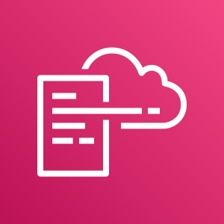
AWS CloudFormation
Gives developers and systems administrators an easy way to create and manage a collection of related AWS resources
Understands dependencies and supports rollbacks and versioning
Allows for reusable component design strategies
Supports JSON and YAML formats

Slide 18



AWS CloudFormation concepts
Template
Stack
Change set

Slide 19
AWS CloudFormation concepts
Stack
Stack
Template
Stack set
Stack
Stack

Slide 20










AWS CloudFormation concepts
An AWS CloudFormation stack is a single unit used to manage related resources
You can create, update, and delete resources by creating, updating, and deleting stacks
Stacks are created from templates
Change sets allow you to edit your stacks
Virtually every kind of AWS resource can be managed via stacks
Stack

Slide 21



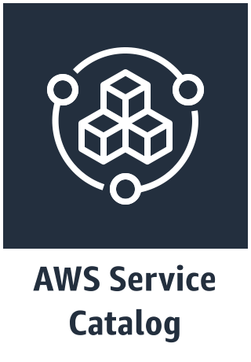

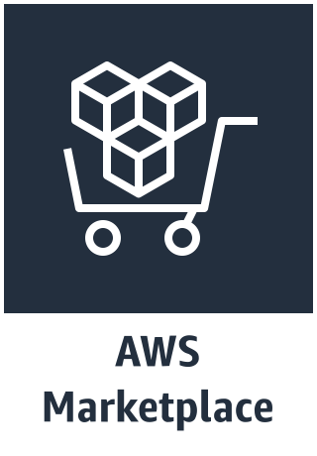

Self-service with preconfigure compliance
JSON, YML or Terraform
Constrains
Security controls
Parameter validation
IAM assignment
Tag enforcement
AWS product/service
AWS Service Catalog
Customer-created AWS-based solution
AWS Marketplace
3rd-party products
Admin
Standardizes best practices
Notes:
This is where AWS Service Catalog comes into play. With service catalog, you leverage infrastructure as code to define your infrastructure, compute, storage and other cloud resources, using JSON, YML or Terraform scripts or files. You use version control practices to maintain versioning control on those scripts or files. You then import those IaC files into Service Catalog, apply security controls, define and enforce tagging, group the resulting product(s) by category (i.e. Dev/Test products or Data Analytics products, etc.) and assign the resulting “products” to a given user, group or role.

Slide 22

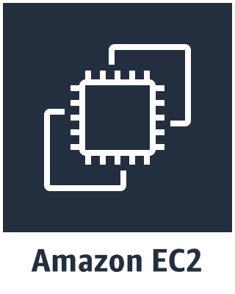



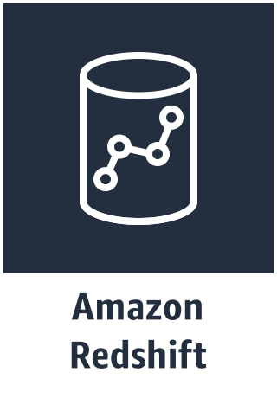
The new state of deployment self-service
User
Compliant with firm polices
Speedy deployment
Correctly tagged
Within budget
WordPress
VMs, containers,
services
AWS Service Catalog
Bitnami Certified App: WordPress
User’s custom product list
Notes:
The tasks performed by the Service Catalog Administrator enables the user’s self-service portal with a list of curated and approved products tailored for each end-user – such that they have the ability to only launch products that are compliant with the company’s policies. The result is that end users, like developers, data scientist or business users, have quick and easy access to a custom, curated list of products that can be deployed consistently, always in compliance and always secure.

Slide 23
The final handshake
Security
Speed
Curation
Compliance
Standardization
Agility
Self-Service
Time to market
Service catalogs enable organizations to deploy and manage infrastructure and applications that reflect the organization’s security and operational policies
Organizations
End Users
Notes:
For today’s digital businesses, cloud-first transformation is in full effect. I think it is obvious why this is happening—a cloud-first mindset enables unlimited scalability, agility, efficiency and more. Using cloud resources for agility, however, challenges enterprise IT with the risk of surprise spending, unforeseen outages, poor performance, and security breaches.
To capitalize on cloud velocity, organizations must adopt new approaches and tools developed for the cloud. Failing to do this will delay migration, weaken overall security posture and cost time and money, losing the agility they seek.

Slide 24

Self-service account provisioning in AWS Service Catalog
Product X
Account factory
1
AWS Control Tower administrator
Publishes account factory as a product to AWS Service Catalog
Publish account factory
Versions
Versions
AWS Service Catalog
AWS Service Catalog end users
Users only see products they are entitled to and can launch, update, and terminate
Portfolio team A
Portfolio team B
3
Self-service provisioning
2
AWS Service Catalog administrator
Administrators organize, govern, and entitle users to portfolios of products
Organize
and entitle
Users, groups, roles
Constraints
Tag options
Users can configure and provision AWS accounts and resources without needing full privileges to AWS services (e.g., Amazon Elastic Compute Cloud (Amazon EC2), Amazon Relational Database Service (Amazon RDS))
Notes:
Service Catalog provides a single location for you to centrally manage catalogs of pre-approved resources. Products are individual AWS resources and portfolios are collection of products for easy management. You can create customized portfolios and selectively grant access to end users for provisioning.
Admins can grant access to Products that users can launch, without needing to give users direct access to the underlying AWS services that provision those resources.

Slide 25

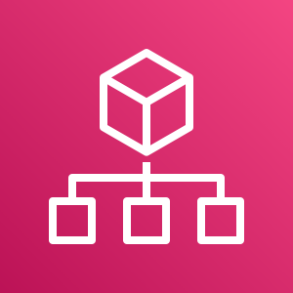
Enable secure self-service provisioning
Create best practice templates
Create AWS Service Catalog products in AWS Control Tower
Distribute products via AWS Organizations
Notes:
Create best-practices templates with AWS CloudFormation or Terraform (Amazon EMR, Amazon EC2, etc.)
Create AWS Service Catalog products in the master AWS Control Tower account
Distribute products via AWS Organizations to all of your AWS Control Tower managed accounts

Slide 26
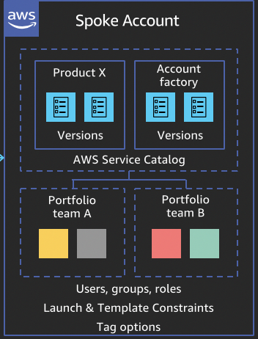
Automate Governance at Scale
Hub Account
Product X
Account factory
Spoke Account
Versions
Versions
2
Product X
Account factory
3
AWS Service Catalog
Centralized Sharing
Self-service provisioning
Portfolio team A
Portfolio team B
Versions
Versions
Developers, Data Scientists
AWS Service Catalog
Portfolio team A
Portfolio team B
Constraints
Tag options
Users, groups, roles
Launch & Template Constraints
Tag options
1
Organize
and entitle
Cloud Admins, Security, Platform Teams
Notes:
Eric Westfall
Spoke Account:
Create local portfolio
Imports the hub portfolio products and Adds product imported to the portfolio.
Inherited Constraints
Inherited Tags
Sets up launch and template constraints.
Add Local Tags
Grants the end-user access to the local portfolio.

Slide 27
Management & Governance
—
Enable
—
Provision
—
Operate
Business agility + governance control
Notes:
From working with thousands of customers, we’ve learnt that there are 3 aspects to achieving BOTH business agility AND governance control.
Customers can enable, provision, and operate across all their resources in AWS and on-premises.
Let’s look at what each of these mean.

Slide 28
Operate with agility + control
Operate
Audit
Audit resource configurations, user access, and policy enforcement
Monitor
Monitor resources and workloads
YOUR AWS RESOURCES ARE GROWING OVER TIME
YOUR AWS RESOURCES ARE GROWING OVER TIME
Dashboard
Continuous visibility into your multi-account environment
Act
Take operational action on resources
Notes:
Cloudwatch, Config Rules, Config, System Managers, AWS CT. Ping Jeane - PMM
There are 4 aspects to this.
{click}
First customers want to monitor and get visibility into how their resources and applications are being used and how they are performing.
{click)
Then they want to make sure it’s auditable. Everything from how those resources are configured, to which users are accessing them, and what policies are being enforced.
(click)
Third they want to take operational action on those resources, to manage them at scale, logically group them and automate operational tasks safely and securely at scale.
(click)
And of course they want to continue to optimize and analyze, to reduce cost, improve efficiency and security posture.

Slide 29
How to Automate
Notes:
Customers want to enable their AWS environment for governance at scale knowing their accounts, resources, and teams will grow over time.

Slide 30


Demo 1 - Automate Sharing Portfolios
Hub Account
Generates a CloudFormation template with portfolios that can be shared
Spoke Account
Automates the process to import and use the shared portfolio

Slide 31
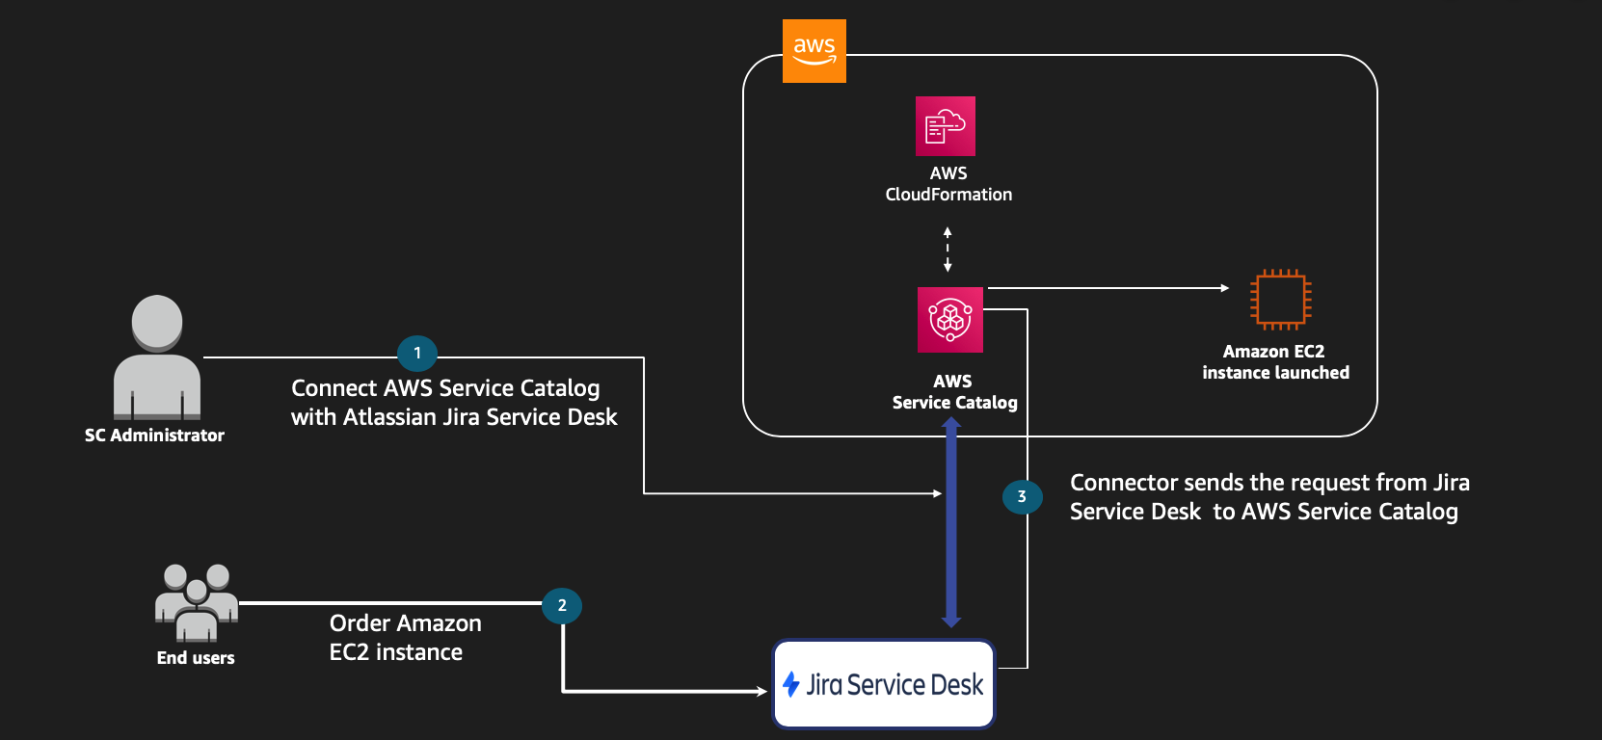
Demo 2 – Request Products via Jira Service Desk

Slide 32
Outcomes
Delivery of production systems by multi-disciplinary teams
Improve operational efficiency
Service template consumption
Consistent framework for overall adoption and acceleration
Enforce compliance
Enhance customer satisfaction

Slide 33
Call to action [Needs to be Updated]
Learn and be curious
AWS Service Catalog
Reference Architectures – https://tinyurl.com/wezhpzq
ITSM Connectors - https://tinyurl.com/qqmuqyj
AWS CloudFormation
TBD
TBD
Provide feedback
Let’s get customer’s workloads into production!

Slide 34
Thank you! Please give us your feedback by completing the session survey in the mobile app.
Ken Walsh
kenwalsh@
MaSonya Scott
masonyas@

